Slide 1
Autoimmune Hepatitis
AASLD 2010 practice guidelines
By
Ahmed Abudeif Abdelaal
Assistant Lecturer of Tropical Medicine & Gastroenterology
Sohag Faculty of Medicine
2013

Slide 2
Definition of autoimmune hepatitis (AIH)
- It is a chronic relapsing hepatitis, associated with a plasma cell hepatic infiltrate, hypergammaglobulinaemia and positive autoantibodies.
- Exclusion of drug precipitants and inherited metabolic liver disease in addition to confirmation of negative viral studies is required.

Slide 3
Epidemiology
- Patients of all ages, both genders and all races may develop AIH.
- Females affected more than males (3.6:1).
AIH accounts for 11% to 23% of cases of chronic hepatitis and affects 100,000 to 200,000 persons in the USA.
- AIH accounts for 2.6% of liver transplants in Europe and 5.9% in the USA.

Slide 4
Natural History
- Data on the natural progression of untreated disease are derived principally from experiences published prior to the widespread use of immunosuppressive agents for AIH and before the detection of the hepatitis C virus (HCV).
- These studies showed that as many as 40% of patients with untreated severe disease died within 6 months of diagnosis, and that survivors frequently developed cirrhosis (40%),

Slide 5
esophageal varices (54%) and subsequent hemorrhage (20%).
- An acute onset of illness is common in as many as 40% of patients, and an acute severe presentation, characterized by hepatic encephalopathy within 8 weeks of clinical symptoms, is sometimes seen.

Slide 6
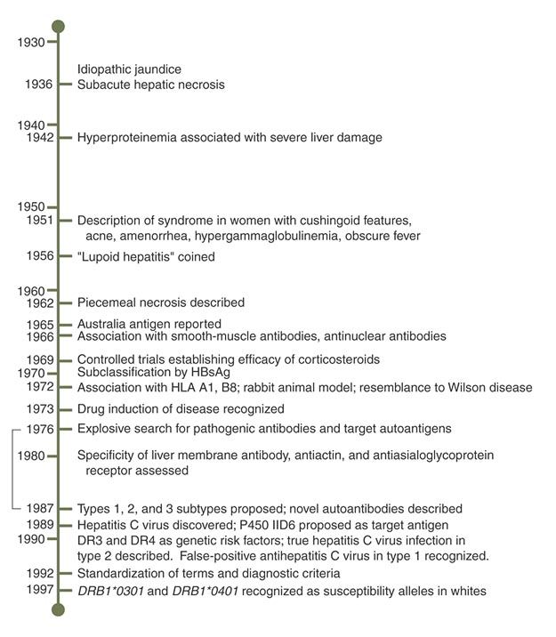
Prof. Waldenström
Prof. Kunkel
Notes:
Appreciation for an autoimmune aetiology emerged in the 1940s as Waldenström recognized the relevance of hypergammaglobulinaemia in chronic hepatitis, and Kunkel described a persistent liver disease predominantly in young females with hypergammaglobulinaemia, alongside extrahepatic symptoms including rash, arthralgias, fever and amenorrhoea.

Slide 7
Pathogenesis
- A working model for its pathogenesis postulates that environmental triggers, a failure of immune tolerance mechanisms, and a genetic predisposition collaborate to induce a T cell–mediated immune attack upon liver antigens, leading to a progressive necroinflammatory and fibrotic process in the liver.

Slide 8
Genetic predisposing factors:
HLA-DRB1*03: early onset, severe form, less response to therapy and greater frequency of liver transplantation.
HLA-DRB1*04: Caucasian population, female predominance, late onset, better response to steroids and higher incidence of extrahepatic manifestations.

Slide 9
Environmental Triggers:
Presumed to be certain viruses (e.g following HAV), toxins, drugs.
Drugs:
- Oxyphenisatin.
- Methyldopa.
- Nitrofurantoin.
- Diclofenac.
- Minocycline.
- Statins.
Notes:
Oxyphenisatine is a laxative. It is closely related to bisacodyl and phenolphthalein. Long term use is associated with liver damage, and as a result, it was withdrawn in most countries in the early 1970s.
Minocycline is a broad-spectrum tetracycline antibiotic

Slide 10
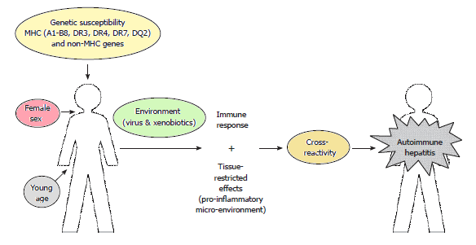
Influence of Genes, Sex, Age and Environment on the Onset of Autoimmune Hepatitis, Journal of Gastroenterology, 2009

Slide 11
Diagnosis of Autoimmune Hepatitis

Slide 12
The diagnosis of AIH requires the presence of characteristic clinical and laboratory features, and the exclusion of other conditions that cause chronic hepatitis and cirrhosis.
Autoimmune Hepatitis
Hypergammaglobulinaemia
Plasma cell interface hepatitis
Autoantibodies
Notes:
Interface hepatitis (piecemeal necrosis): is a process of inflammation and erosion of the hepatic parenchyma at its junction with portal tracts or fibrous septa.

Slide 13
Clinical Picture
There is a broad spectrum of clinical manifestations, ranging from asymptomatic to fulminant hepatic failure with approaching 10% of patients presenting with acute liver failure.
AIH can be asymptomatic or symptomatic.
Asymptomatic presentation:
AIH can be asymptomatic in 34%-45% of patients.
Typically these patients are men and have

Slide 14
significantly lower serum ALT levels at presentation than do symptomatic patients.
The frequency of cirrhosis is similar to that in symptomatic patients.
About 70% of asymptomatic patients become symptomatic during the course of their disease, so they must be followed lifelong to monitor for changes in disease activity.

Slide 15
- Symptomatic presentation
- Onset is frequently insidious with non-specific symptoms such as fatigue (85%), jaundice, nausea, abdominal pain, arthralgia, arthritis, acne and amenorrhea.
Acute presentations are often indistinguishable from a viral illness, and hepatic discomfort, anorexia and nausea may be evident.
Chronic presentations can range from firm hepatomegaly, splenomegaly to other features

Slide 16
of chronic liver disease including palmar erythema and spider navei.
- Assciated autoimmune diseases
Autoimmune diseases are evident in as many as one in three patients: Sjögren’s syndrome, autoimmune thyroid disease, autoimmune haemolysis, rheumatoid arthritis, ulcerative colitis, idiopathic thrombocytopenic purpura, type 1 DM and vitiligo stand out.

Slide 17
- Coeliac disease can be coexistent, but care needs to be taken to ensure liver abnormalities
are not secondary to coeliac disease itself.
Serological patterns of autoreactivity permit two major subclassifications of the disease.
Type 1 is characterized by ANA and/or SMA.
Type 2 is characterized by anti-LKM1. Type 2 presents more acutely, at younger age and IgA deficiency is often noted, whereas symptoms, signs, family history, associated autoimmune

Slide 18
diseases and treatment response are similar for both serological groups.
Type 2 AIH | Type 1 AIH
20% in Europe, 4% in USA | > 80% | Relative prevalence
LKM1 | ANA, SMA | Autoantibodies commonly associated
Female: male ratio 9:1 | Female: male ratio 4:1 | Patient demographic
Average 10 y old but seen in adults (Europe) | Peak incidence 16-30 y, although 50% are > 30 y | Age of onset
Prevalence unclear: Type 1 DM, thyroid disease, vitiligo, pernicious anemia, IgA deficiency | Prevalence of 17-48%: thyroid disease, rheumatoid arthritis, ulcerative colitis | Other commonly associated autoimmune diseases
Frequently presents with cirrhosis in children and more aggressively | Acute onset rare | Presentation
May be more treatment resistant | Excellent response | Response to treatment
∼ 80% develop cirrhosis | 25% have cirrhosis at diagnosis; 45% develop cirrhosis | Progression of disease

Slide 19
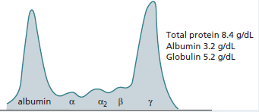
Laboratory Findings
A) Liver biochemistry & immunoglobulins
- Elevated IgG values, commonly 1.2-3 times
ULN.
Electrophoresis of the serum proteins showing very high γ- globulin

Slide 20
Elevation of transaminases ranging from minor values to levels in the thousands.
Elevated ALP values can be seen, but if greater than 3 fold, should prompt additional biliary investigations.
Jaundice, coagulopathy and hypoalbuminaemia may be noted in very acute presentations.
Haemolysis is a feature that should prompt exclusion of Wilson’s disease.

Slide 21
B) Serological assessment
ANA and SMA categorize type 1 AIH, whilst anti-LKM1 mark type 2 AIH.
Usual titres of serum autoantibodies are at or above 1 in 40-80.
Lower titres at or above 1/20, are of significance only in children.
In pediatric populations (<18 years), titers are useful biomarkers of disease activity and can be used to monitor treatment response.

Slide 22
- Autoantibody titres in adults only roughly correlates with disease severity, clinical course and treatment response. So, they are only of diagnostic value.
Autoantibodies are not specific to AIH and their expressions can vary during the course of the disease. Furthermore, low autoantibody titers do not exclude the diagnosis of AIH, nor do high titers (in the absence of other supportive findings) establish the diagnosis.

Slide 23
Seronegative disease may also occur, seronegative individuals may express conventional antibodies later in the disease or exibit non-standard autoantibodies.

Slide 24
Antinuclear antibodies (ANA)
ANA are present alone (approximately 10%) or with SMA (approximately 50%) in two thirds of patients.
ANA in AIH are not specific.

Slide 25
2) Smooth muscle antibodies (SMA)
SMA are present in approximately 90% of patients with AIH, either as the sole marker of the disease (approximately one-third) or in conjunction with ANA (approximately half).
SMA is very non-specific, and low titre antibody results are frequent in healthy individuals, particularly in those over 60 years of age, as well as those with an assortment of viral, autoimmune or malignant disease.

Slide 26
3) Anti-F-actin antibodies
Are more specific for type 1 AIH.
Present in 74% with type 1 AIH and 86% with SMA.
Associated with early age of onset, death from liver failure or need for liver transplantation compared with patients with ANA.
Assays are not universally available.

Slide 27
4) Microsomal antibodies (LKM)
Four subclassifications of LKM:
LKM-1: associated with type 2 AIH and chronic HCV infection.
LKM-2: associated with the hepatitis caused by the medication ticrynafen (tienilic acid). taken off the US market in 1982
LKM-3: associated with type 2 AIH and chronic HDV infection.
Notes:
Tticrynafen: is a loop diuretic drug with uric acid-lowering action, formerly marketed for the treatment of hypertension. It was approved by FDA on May 2, 1979, and withdrawn in 1982, after case reports in the United States indicated a link between the use of ticrynafen and hepatitis.

Slide 28
- LKM-4: described in patients with AIH associated with (APECED).
Notes:
Autoimmune polyendocrinopathy - candidiasis - ectodermal dystrophy (APECED).

Slide 29
5) Antibodies to liver cytosol type 1 (anti-LC1)
Possibly useful as markers of severity and/or residual liver inflammation in type 2 AIH.
- Commonly associated with anti-LKM1 (32%).
Detected mainly in patients up to 20 years old, rare in patients older than 40 years.
Serum levels fluctuating with disease activity and response to treatment.

Slide 30
Associated with frequent concurent immune diseases, rapid progression to cirrhosis and severe inflammation.
No commercial assay available.

Slide 31
6) Soluble liver and pancreas antigen (SLA/LP)
Highly specific for AIH (99%), but limited sensitivity.
It is a better marker of AIH than ANA or SMA, since normal individuals and those with non-hepatic disorders are SLA/LP negative.
Possible marker for genetic predisposition for severe disease and relapse after drug withdrawal.

Slide 32
Initially, individuals who were SLA/LP positive were classified as type 3 AIH, since it was observed first among patients negative for ANA, SMA and LKM. However three-quarters of patients with so-called type 3 AIH are also ANA and/or SMA positive, and clinically these individuals are indistinct from those with type 1 disease; conversely 10-30% of patients with type 1 AIH when tested are SLA/LP positive.
Commercial ELISAs are available for their detection.

Slide 33
7) Mitochondrial antibodies (AMA)
AMA may be found in AIH in as many as 20% of patients.
They are usually lower in titre (≤ 1:40).
The presence of AMA must not be directly taken to imply an AIH-PBC overlap syndrome.
Long-term study of patients with AIH who are persistently AMA positive shows these individuals to have the same laboratory, histological and clinical features, as well as the

Slide 34
same treatment outcomes compared to individuals who are AMA negative.

Slide 35
8) Atypical p-ANCA
Originally considerd specific for PSC and IBD, are frequently present in patients with AIH, and occasionally can be the only autoantibodies detected.
p-ANCA typically do not coexist with anti-LKM1.

Slide 36
9) Antibodies to asialoglycoprotein receptor (anti-ASGPR)
Present in 88% of AIH regardless of type.
Associated with higher frequency of relapse after corticosteroid withdrawal.
Correlated with inflammatory activity within liver tissue and useful in defining end points of therapy.
Commercial assay in development.

Slide 37
10) Other antibodies (as prognostic markers)
Anti-chromatin: more common in men than women; more common during active disease; more frequent in patients who relapse.
Anti-double stranded DNA (anti-dsDNA).
Anti-cyclic citrullinated peptides (anti-CCP): associated with higher frequency of rheumatoid arthritis, greater occurrence of cirrhosis at presentation and death from liver failure.

Slide 38
C) Genetic considerations
AIH is a complex polygenic disorder unlikely to be transmitted to subsequent generations; thus, routine screening of patients or family members for genetic markers is not recommended.
AIH may be present in patients with APECED, which is the only syndrome involving AIH that exhibits a Mendelian pattern of inheritance, and genetic counseling for the patient and family members are warranted.
Notes:
Autoimmune polyendocrinopathy - candidiasis - ectodermal dystrophy (APECED).

Slide 39
Liver biopsy and histological features
Liver biopsy should always be performed to:
Identify features suggestive of AIH.
To exclude alternative liver disease.
To estimate fibrosis.
- To minimize sampling error, care to obtain adequately sized liver specimens (≥ 2.5 cm) is essential as both parenchymal and biliary evaluation are important.

Slide 40
Histological features
Lymphoplasmacytic interface hepatitis.
Esinophils, lobular hepatitis, bridging, centrizonal (zone 3) and multiacinar necrosis may be present.
Some degree of fibrosis is present and with advanced disease bridging fibrosis or cirrhosis is seen.
The portal lesions generally spares the bile ducts but up to 10% of biopsies may show duct
Notes:
Interface hepatitis (piecemeal necrosis): is a process of inflammation and erosion of the hepatic parenchyma at its junction with portal tracts or fibrous septa.

Slide 41
destruction and an additional 10% show lymphocytic infiltration without ductopenia, the histological pattern of injury may be indistinguishable from PBC.
- Granulomas rarely occur.
-N.B: Histological appearance of AIH remains the same as that of chronic hepatitis, and although certain changes are common, no findings are specific.

Slide 42
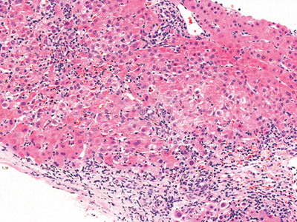
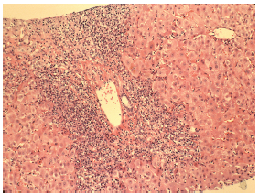
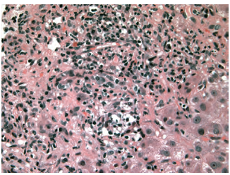
Interface hepatitis (piecemeal necrosis)
Histopathology of interface hepatitis. The limiting plate of the portal tract is disrupted by a lymphoplasmacytic infiltrate.

Slide 43
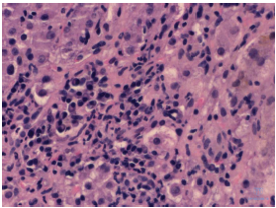
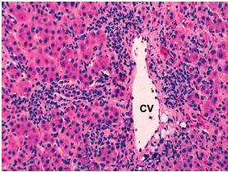
Plasma cell infiltration of the portal tracts
Centrizonal (zone 3) necrosis

Slide 44
Simplified grading
Histology was graded typical, compatible with AIH and atypical.
Typical: each of the 3 histological features of classic AIH had to be present (lymphocytic/ lymphoplasmacytic interface hepatitis, emperipolesis and hepatic rosette formation).
Compatible features: are a chronic hepatitis with lymphocytic infiltration without all the features considered usual.
Atypical: when showing signs of another diagnosis, such as steatohepatitis.
Notes:
Emperipolesis is the presence of an intact cell within the cytoplasm of another cell.
It is seen in various conditions including:
1) Rosai-Dorfman disease known as sinus histiocytosis with massive lymphadenopathy, is a rare disorder of unknown etiology that is characterized by abundant histiocytes in the lymph nodes throughout the body. The disease is usually non-progressive and self-limited, but patients can manifest autoimmune hemolytic anemia.
2) Autoimmune hepatitis
3) Megakaryocytes containing segmented neutrophils

Slide 45
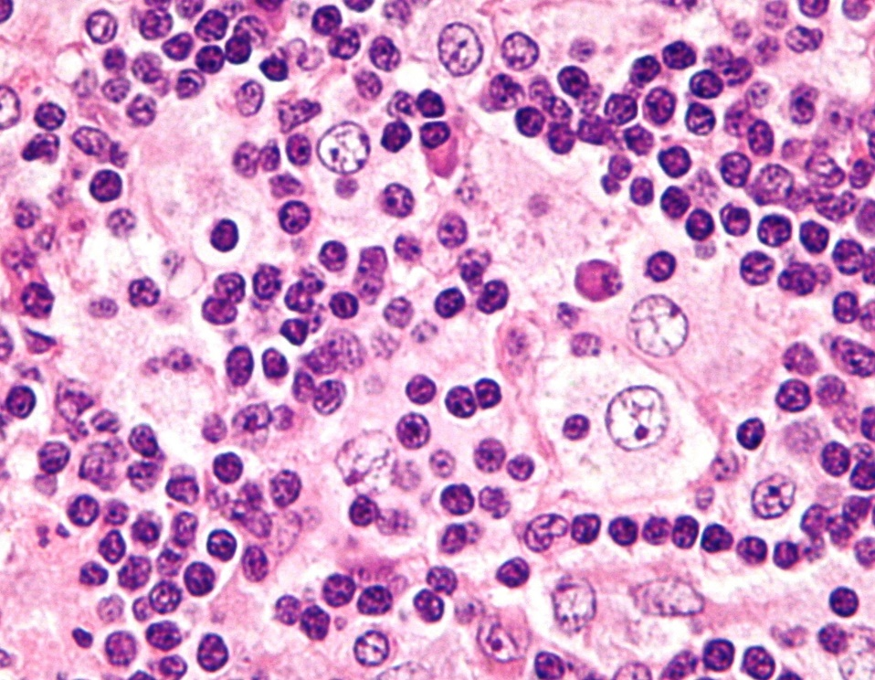
Emperipolesis

Slide 46
Imaging
Imaging is unlikely to help in the diagnosis of AIH but it is of use in excluding important differential diagnoses, in particular acute Budd-Chiari, infiltrative disease and unsuspected biliary processes.
Biliary overlap is reported, so MRCP should be routinely considered for those with AIH.
Periportal lymphadenopathy is a common finding in those with autoimmune liver disease and is rarely lymphoma.

Slide 47
Criteria for Diagnosis

Slide 48
International criteria for definite or propable diagnosis of AIH (1999)
Propable diagnosis | Definite diagnosis | Diagnostic features
- Daily alcohol <50g/day. - No recent hepatotoxic drugs. - Heterozygous α₁-AT deficiency . - Abnormal copper or ceruloplasmin level but Wilson disease excluded. - Nonspecific iron &/or ferritin abnormalities. - No active hepatitis A, B, C. | - Daily alcohol <25g/day. - No recent hepatotoxic drugs. - Normal α₁-AT phenotype. - Normal ceruloplasmin level. - Normal iron and ferritin levels. - No active hepatitis A, B, C. | Exclusion of risk factors of other diseases
- Serum AST/ALT elevation. - Minimal mild cholestatic changes. | - Serum AST/ALT elevation. - Minimal mild cholestatic changes. | Inflammatory indices
- ANA, SMA or LKM1 >1:40 in adults; other autoantibodies. | - ANA, SMA or LKM1 >1:80 in adults & >1:20 in children; no AMA. | Autoantibodies
- Hypergammaglobulinaemia of any degree. | - Globulin, γ- globulin or IgG level > 1.5 times normal. | Immunoglobulins
- Interface hepatitis, moderate to severe. - No biliary lesions, granulomas or prominent changes suggestive of another disease. | - Interface hepatitis, moderate to severe. - No biliary lesions, granulomas or prominent changes suggestive of another disease. | Histologic findings

Slide 49
The clinical criteria for the diagnosis are sufficient to make or exclude definite or probable AIH in the majority of patients.
Two scoring systems were developed for the diagnosis of difficult challenging cases:
The revised original scoring system of the IAIHG (1999), which is most useful in patients with few or atypical symptoms.
The simplified scoring system of the IAIHG (2008), which is most useful in patients with other diseases and concurrent autoimmune features.
Notes:
IAIHG = International Autoimmune Hepatitis Group

Slide 50
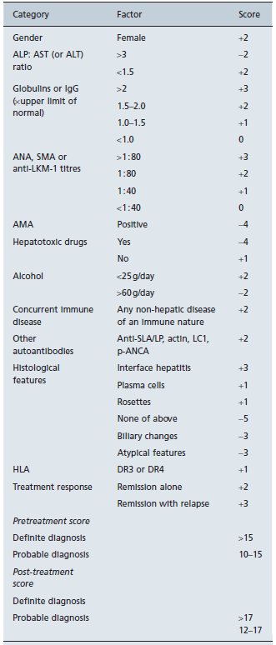
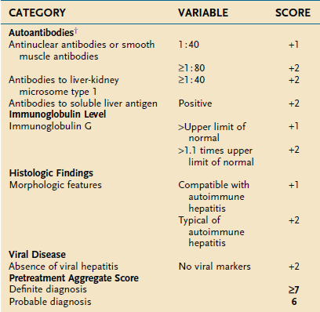
The simplified scoring system of the IAIHG (2008)
The revised original scoring system of the IAIHG (1999)

Slide 51
Differential Diagnosis of Autoimmune Hepatitis

Slide 52
1) Drug induced liver injury
Drug related injury can mimic every clinical, biochemical, serological and histological feature of AIH.
Clinically, care must be taken to examine for significant lymphadenopathy, rash or neurological changes.
Peripheral blood eosinophilia may suggest a drug injury; the so called DRESS syndrome includes a hepatitis in half of these cases.
Notes:
DRESS syndrome: drug rash with eosinophilia and systemic symptoms

Slide 53
Drugs implicated in precipitating an autoimmune like hepatitis are:
Minocycline
Nitrofurantoin
Statins
Anti-TNF agents
IFN-α
Indometacin
Ramipril
Terbinafine
Orlistat
Dihydralazine
Methyldopa
Halothane
Diclofenac
Fenofibrate

Slide 54
2) Viral hepatitis
Including:
HAV
HBV
HCV
HDV
HEV
EBV
Adenovirus
Parvovirus

Slide 55
3) Wilson’s disease
With an acute presentation of Wilson’s disease all the features of AIH, including raised globulins, SMA and an active histological hepatitis,may be observed.
Careful interpretation of urine copper excretion and liver copper estimation are most valuable.
Coexistent haemolysis is always a clear sign that Wilson’s disease needs to be excluded.

Slide 56
4) α₁-antitrypsin deficiency
In children it represents an additional differential diagnosis for AIH.
The combination of serum testing and typical histology (in particular the periportal red hyaline globules seen with PAS stain) should rapidly confirm the diagnosis.

Slide 57
5) Lupus
SLE is considered in patients with arthralgias in particular, but the presence of anti-dsDNA is a feature of AIH.
In SLE the commonest reason for elevated liver enzymes is NAFLD.
6) Alcohol

Slide 58
Diagnostic Difficulties

Slide 59
1) Autoantibody-negative patients
Approximately 10-20% of AIH patients are initially seronegative for the conventional autoantibodies, which may appear after a few weeks or even after immunosuppressive therapy is begun, or remain negative despite repeat testing.
Evaluation for the highly specific anti- SLA/LP antibodies, if available, should be considered.
If patients meet the diagnosis of AIH based on other criteria, they should be considered for

Slide 60
immunosuppressive therapy, regardless of antibody status.

Slide 61
2) Viral hepatitis
20-40% of patients with chronic HBV or HCV are persistently positive for various autoantibodies, usually, but not always, at low titres (1:20 or 1:40).
Distinction of chronic viral hepatitis from AIH is important, because IFN therapy can potentially exacerbate autoimmune conditions, and corticosteroids can enhance viral replication.

Slide 62
3) Mixed clinical and histological features
PSC and PBC can have clinical, laboratory, histological, and genetic findings that resemble those of AIH, and AIH can have features that resemble each of these cholestatic syndromes.
These nonspecific shared features can confound the diagnosis of AIH.
The prevalence of AIH among patients with PSC was determined to be 8%.

Slide 63
Clinical judgment is required to determine the predominant phenotype of the disease and to manage the process appropriately.

Slide 64
4) Coeliac disease
It can be seen coincidentally with liver disease, or may itself be a cause of liver test abnormalities and liver dysfunction, with a prevalence of coeliac disease in those with cryptogenic cirrhosis estimated at 4%.
The false positive rate of antitissue transglutaminase antibody testing has however been estimated to be nearly 50% in those with PBC and AIH.

Slide 65
Therefore when testing for coeliac disease in patients with autoimmune liver disease, small bowel biopsy must follow a positive antitissue transglutaminase test.

Slide 66
Hepatocellular carcinoma and AIH
HCC occurs in 4% of patients with type 1 AIH, and the 10-year probability of developing this neoplasm is 2.9%.
The risk of HCC is related to:
Male sex.
Portal hypertension manifested by ascites, esophageal varices, or thrombocytopenia.
Immunosuppressive treatment for at least 3 years.
Cirrhosis of at least 10 years duration.
- Surveillance by abdominal US should be done every 6 months for these individuals.

Slide 67
Pregnancy and AIH
1) Impact on pregnancy
The natural history of AIH is variable during pregnancy.
Successful pregnancies can occur in women with well-controlled AIH.
The rate of fetal loss is 19-24% (similar to that from other chronic diseases).

Slide 68
2) Treatment
Cessation of therapy during pregnancy is associated with relapse of disease.
The use of azathioprine is controversial, but reports of experience in patients taking azathioprine following organ transplants or for IBD have described good outcomes for mothers and infants.
Patients should be monitored closely for flare-ups of AIH during pregnancy and in the early postpartum period.

Slide 69
3) Special considerations
Women of childbearing age with AIH should be counseled to consider pregnancy only if the disease is well-controlled.

Slide 70
Treatment of Autoimmune Hepatitis

Slide 71
1) Indications of treatment
Absolute indications for treatment :
1- Serum transaminases ≥ 10 fold ULN.
2- Serum transaminases ≥ 5 fold ULN and γ- globulin level ≥ 2 fold ULN.
3- Histological evidence of bridging or multiacinar necrosis.
4- Incapacitating symptoms or acute severe onset.
b) Relative indications for treatment:
1- Serum transaminases < 10 fold ULN and γ- globulin level < 2 fold ULN.
2- Interface hepatitis.
3- Mild or no symptoms.

Slide 72
c) Not indicated:
1- Asymptomatic with normal or near normal serum transaminases and γ- globulin levels.
2- Inactive cirrhosis or mild portal inflammation (portal hepatitis)
3- Decompensated inactive cirrhosis with intractable ascites, hepatic encephalopathy and/or variceal bleeding.

Slide 73
2) Treatment regimens
- There is 3 treatment strategies:
Prednisone monotherapy or,
Initial monotherapy with steroid with subsequent addition of azathioprine or,
Combination therapy from the start.
- Most clinicians now use a combination regimen from the start, since this is associated with a lower occurrence of corticosteroid related side effects.

Slide 74
3) Induction of remission
Initial monotherapy with subsequent azathioprine |  | Combination therapy from the start |  | High dose monotherapy
Azathioprine (mg/kg/day) | Prednisone (mg/day) | Azathioprine (mg/kg/day) | Prednisone (mg/day) | Prednisone (mg/day)
× | 20-30 | 1-2 | 30 | 60 | Week 1
× | 20-30 | 1-2 | 20 | 40 | Week 2
× | 20-30 | 1-2 | 15 | 30 | Week 3
1-2 if there is response to prednisone | 20-30 | 1-2 | 15 | 30 | Week 4
 | Tapering dose to 5-10 mg by 1 y | 1-2 | 10 | 20 and below | Early maintainance until endpoint
N.B: In USA azathioprine is given in a fixed dose of 50mg/day

Slide 75
4) Maintainance of remission
- Long term remission is maintained by either:
Low dose steroid alone.
Combination therapy with azathioprine at dose of 1mg/kg/day.
Azathioprine alone at dose of 2mg/kg/day then after a further period of remission it is possible to reduce the dose to 1mg/kg/day. Others may use it at a dose of 1mg/kg/day from the start.
- Follow up assessments should occur every 6 months during treatment, or sooner if symptoms of liver failure or drug intolerance are noted.

Slide 76
5) Treatment endpoints
Conventional therapy is continued until remission, treatment failure, incomplete response, or drug toxicity.
Response to immunosuppressive therapy is assessed clinically, biochemically and possibly by repeat histological evaluation.
A complete biochemical response (defined as a decrease in serum aminotransferase and globulins) is the aim and it occurs within 1-3 months.

Slide 77
Histological remission lags behind clinical and biochemical remission by 3-6 months, explaining prolonged maintenance therapy to accommodate this lag.
There is no prescribed minimum or maximum duration of treatment.

Slide 78
1) Remission
Definition:
Ideal endpoint: no symptoms, normal liver tests, normal liver tissue, occurs only in 40%.
Satisfactory endpoint: no symptoms, AST/ALT ≤ 2 fold ULN, other tests normal, no interface hepatitis.
Occurance: 77% within 2 years.
Action:
Gradual drug withdrawal (the prednisone dose can be decreased by 2.5-5 mg every 2-4 wks) over a 6 week period after the treatment endpoint.

Slide 79
Lab. tests should be performed every 3 wk during treatment withdrawal and every 3 wk thereafter for 3 months. Tests should then be performed every 6 months for 1 year after remission and then annually for life.
Outcome:
Relapse in 50% within 6 months and in 70-86% within 3 years.
Sustained remission in 21%.

Slide 80
Factors that predict relapse:
Failure to maintain consistently normal transaminases during therapy.
Time to initial biochemical remission.
High IgG at entry.
Marked portal plasma cell infiltrate.
The duration of therapy preceding withdrawal of immunosuppression.

Slide 81
2) Treatment failure
Definition: worsening clinical, laboratory, and histological features despite compliance with therapy.
Occurance: 9% during initial treatment.
Action:
Prednisone 60mg daily, or prednisone 30mg daily + azathioprine 150mg daily, for at least 1 month.
Dose reduction of prednisone by 10mg and azathioprine by 50 mg for each month of improvement until standard maintainance

Slide 82
treatment doses are achieved.
Outcome:
Clinical and labaratory improvement in 70% within 2 years.
Histological improvement in 20%.
Indefinite therapy is necessary.

Slide 83
3) Incomplete response
Definition: improvement but insufficient to satisfy remission criteria despite compliance with therapy after 3 years.
Occurance: 13% during initial treatment.
Action: long term treatment with low dose prednisone (up to 10mg/day) or azathioprine (2mg/kg/day).
Outcome: Indefinite therapy.

Slide 84
4) Drug toxicity
Definition: development of intolerable side effects.
Occurance: 13%.
Action:
Dose reduction or discontinuation of offending drug.
Maintenance on tolerated drug in adjusted dose.
Outcome: Indefinite therapy with single tolerated drug or low dose offending drug.

Slide 85
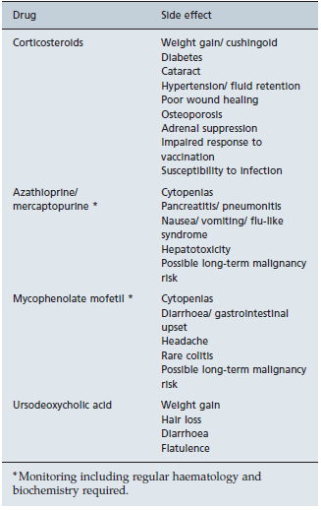
6) Treatment side effects

Slide 86
7) Pretreatment and on-treatment considerations
Consider checking stools for ova and parasites.
Start calcium (1000-1500 mg/day) and vitamin D supplementation (1000 IU/day) .
Consider baseline bone mineral density +/− bisphosphonate prophylaxis.
Check blood pressure and monitor on therapy periodically.
Check blood glucose and urine glucose and monitor on therapy periodically.

Slide 87
Screen for cataracts.
Agree blood monitoring schedule for side effects.
Discuss compliance strategies.
Advise on prevention of infection, e.g. vaccinations, avoidance of bites in endemic areas.
Screen for previous hepatitis B and consider monitoring/intervention based on cAb status.
- Consider the patient for variceal surveillance and HCC screening

Slide 88
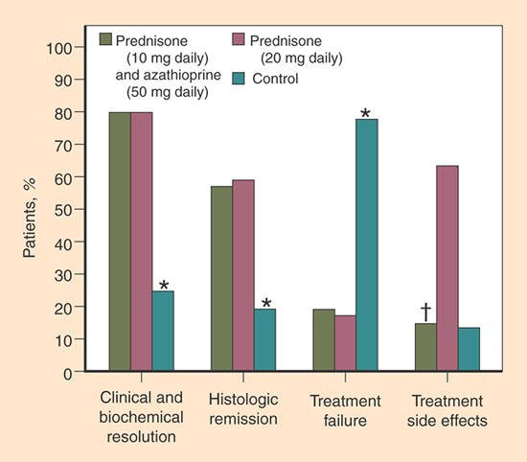

Slide 89
8) Alternative drugs
Cyclosporine.
Tacrolimus.
Mycophenolate mofetil.
6-MP.
Budesonide.
Rituximab (anti-CD20 monoclonal antibody).

Slide 90
AIH and liver transplantation
Indications of LT in AIH:
Acute liver failure.
Decompensated cirrhosis with a MELD score
≥ 15.
Hepatocellular carcinoma meeting transplant criteria (uncommon).
Recurrent AIH in Allografts
Recurrence occurs in 12-46% of patients.
The incidence increases with time after LT and accelerates after discontinuation of steroids.

Slide 91
Reported risk factors for recurrence included inadequate dosing of immunosuppression, type 1 AIH and a recipient positive for either HLA-DRB1*03 or DRB1*04.
De novo AIH after LT (allimmune hepatitis)
This clinical entity has features of a steroid-responsive AIH in patients transplanted for other non-immune indications.
It is characterized by a biochemical hepatitis, circulating autoantibodies, elevated immunoglobulins and an inflammatory

Slide 92
infiltration with interface hepatitis.
Children are more at risk than adults, particularly those undergoing transplant for biliary atresia, but the condition is still relatively uncommon.
There is usually a good response to additional immunosuppression with corticosteroids, but in some cases there is progression to cirrhosis and subsequent graft failure.

Slide 93
Survival of patients with AIH
Overall 10 year survival for treated patients is 93% and 20 year survival exceeds 80%.

Slide 94
Thank you

